Slide 1
Restaurant Location Research Report
Mark Mu
2019.3.25

Slide 2
Project outline
The purpose of this project is to make recommendations to a Chinese restaurant chain owner regarding the location of their next branch in San Francisco, CA.
This project utilizes the Foursquare API, as well as the sklearn package in Python, in order to provide more insight into the geographical distributions of existing Chinese restaurants, so that we can provide ideas as to where to open the next Chinese restaurant.

Slide 3

data acquisition and cleaning
In this project, I use the Foursquare data to find the geographical location information of competing restaurants. In order to retrieve data from the Foursquare database, the Foursquare API is utilized.
The retrieved dataframe contains 40 columns. The number of rows depends on the number of restaurant search results that the API returns.
However, only the location information, namely latitude and longitude, are useful information. The attributes that concerns restaurant tips and visits retrieved from Foursquare API contains all 0 and therefore should be dropped.

Slide 4
data acquisition and cleaning
The final dataframe look something like this

Slide 5
Clustering analysis
K-means clustering analysis is then utilized to analyze the data. This creates label for each restaurant that can be visualized on the map.

Slide 6
China town area Downtown SF
Chinese restaurants forms 5 clusters
High customer flow in this area
Fierce Competition

Slide 7
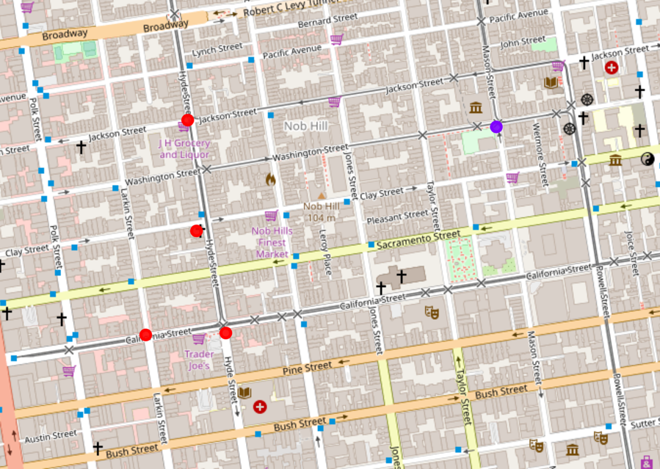
Nob hill area High-end residential area
Chinese restaurants doesn’t really form any cluster
Very few Chinese restaurants due to high land expenses
Fewer competitions and more wealthy potential customers

Slide 8
Sunset area middle class residential area
Chinese restaurants form 2 clusters near the two big market place
Less competition and more potential customers

Slide 9
Richmond area middle class residential area
Chinese restaurants distribution more diverse
Cluster mostly on the three major commercial streets
A little more competition, but more popularity

Slide 10
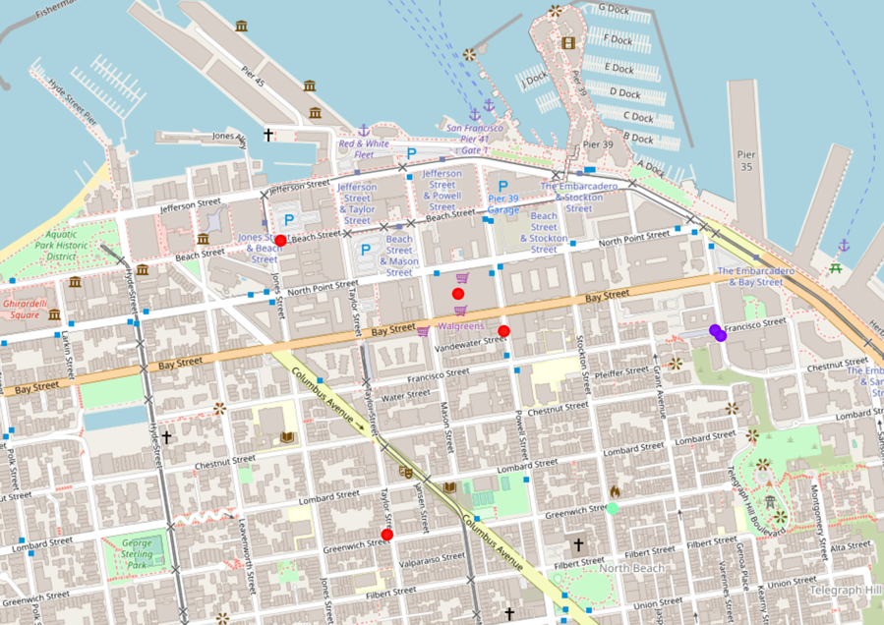
Fisherman Wharf major tourist attraction
Chinese restaurants sparse and does not form any cluster
Tourists does not look for Chinese food when they visit this area
Much less potential customers

Slide 11
Conclusion and discussion
Chinese restaurants typically has the following characteristics
prefer to settle near where China Town is (Obviously!)
prefer to settle where there are more office buildings, in another word, downtown areas
tend to appear in clusters near big market places
tend to avoid high-end residential areas
tend to avoid local tourist attraction spots
Based upon such findings, it is safe to suggest that when look for a spot to open a brand new Chinese restaurant, it is a good idea to first categorize one’s goal.

Slide 12
Conclusion and discussion
As in my case, since my customer is an owner of a high-end Chinese restaurant chain, I would suggest either Sunset, or Nob Hill, since
Opening a brand-new Chinese restaurant near China Town or Richmond area would be a bad idea because these areas are already crowned and there are few potential wealthy customers who are interested in high-end Chinese food
Fisherman’s Wharf would also be a bad idea since the area is crowed with tourists who are not interested in Chinese food anyways. Hence, Nob Hill and Sunset seems to be better choices

Slide 13
bon appétit!

